Slide 1
Passing Arrays to Functions Concept of Pass-by-Value & Pass-by-Reference

Slide 2
Outline
Passing a 1-D array to a function
An array is passed by reference
Passing a 2-D array to a function

Slide 3
1. Passing a 1-D Array to a Function
Why do we mention specifically about passing arrays to functions?
Short Answer: There are both syntactical and conceptual issues.
Let's start with syntax first

Slide 4
1. Passing a 1-D Array to a Function
1
2
3
4
5
6
7
8
9
10
11
12
13
14
15
16
17
void printArray(int array [], int arraySize) {
int i;
for (i = 0; i < arraySize; i++)
printf("%d ", array[i]);
printf("\n");
}
int main(void) {
int A[5] = { 1, 2, 3, 4, 5 }, B[10] = { 0 };
printArray( A, 5 ); // Output "1 2 3 4 5 "
printArray( B, 10 ); // Output "0 0 0 0 0 0 0 0 0 0 "
printArray( A, 3 ); // Output "1 2 3 "
return 0;
}

Slide 5
1. 1-D Arrays as Formal Parameters
1
2
3
4
5
6
7
8
9
10
11
12
13
14
15
16
17
void printArray(int array [], int arraySize) {
int i;
for (i = 0; i < arraySize; i++)
printf("%d ", array[i]);
printf("\n");
}
int main(void) {
int A[5] = { 1, 2, 3, 4, 5 }, B[10] = { 0 };
printArray( A, 5 ); // Output "1 2 3 4 5 "
printArray( B, 10 ); // Output "0 0 0 0 0 0 0 0 0 0 "
printArray( A, 3 ); // Output "1 2 3 "
return 0;
}
Needs a pair of [] after the parameter name.
Number inside [], if any, is ignored inside the function.

Slide 6
1. 1-D Arrays as Actual Parameters
1
2
3
4
5
6
7
8
9
10
11
12
13
14
15
16
17
void printArray(int array [], int arraySize) {
int i;
for (i = 0; i < arraySize; i++)
printf("%d ", array[i]);
printf("\n");
}
int main(void) {
int A[5] = { 1, 2, 3, 4, 5 }, B[10] = { 0 };
printArray( A, 5 ); // Output "1 2 3 4 5 "
printArray( B, 10 ); // Output "0 0 0 0 0 0 0 0 0 0 "
printArray( A, 3 ); // Output "1 2 3 "
return 0;
}
The actual parameter (argument) can be a 1-D array of the same data type of ANY size.
The array name, "A" or "B", already represents an "array of int".

Slide 7
1. Indicating Array Size via a Parameter
1
2
3
4
5
6
7
8
9
10
11
12
13
14
15
16
17
void printArray(int array [], int arraySize) {
int i;
for (i = 0; i < arraySize; i++)
printf("%d ", array[i]);
printf("\n");
}
int main(void) {
int A[5] = { 1, 2, 3, 4, 5 }, B[10] = { 0 };
printArray( A, 5 ); // Output "1 2 3 4 5 "
printArray( B, 10 ); // Output "0 0 0 0 0 0 0 0 0 0 "
printArray( A, 3 ); // Output "1 2 3 "
return 0;
}
The function is unaware of the size of the actual parameter; the size is usually indicated using a separate parameter.

Slide 8
2. A Curious Example
1
2
3
4
5
6
7
8
9
10
11
12
13
14
15
16
void clear(int A[], int size, int B) {
int i;
for (i = 0; i < size; i++)
A[i] = 0;
B = 0;
}
int main(void) {
int C[3] = { 1, 2, 3 };
int D = 10;
clear(C, 3, D);
printf("%d %d %d %d\n", C[0], C[1], C[2], D);
return 0;
}
What is the output?
Any difference between parameter int A[] and int B?

Slide 9
2. A Curious Example
1
2
3
4
5
6
7
8
9
10
11
12
13
14
15
16
void clear(int A[], int size, int B) {
int i;
for (i = 0; i < size; i++)
A[i] = 0;
B = 0;
}
int main(void) {
int C[3] = { 1, 2, 3 };
int D = 10;
clear(C, 3, D);
printf("%d %d %d %d\n", C[0], C[1], C[2], D);
return 0;
}
The actual output is:
0 0 0 10
Array C is updated by function
But integer D doesn’t
Why would that be?

Slide 10
2. Array is passed to a function by reference
When passed to a function via a parameter
The array is passed by reference.
The ordinary variable is passed by value.
When a parameter is passed by reference, modifying the formal parameter has the same effect on the actual parameter.
That is, an array parameter is SHARED between two functions, as an actual parameter at the caller side AND as a formal parameter at the callee.

Slide 11
2. When an int parameter is passed by value
1
2
3
4
5
6
7
8
9
10
11
12
13
14
15
16
void clear(int a) {
a = 0;
}
int main(void) {
int b = 5;
clear(b);
// After line 8 is executed,
// b remains 5
return 0;
}
a
5
Value of b is copied to a
b
5
When a parameter is passed by value, the value of the actual parameter is copied to the formal parameter; they have their own storage space.
If you print the addresses of a and b, they are obviously two different memory locations

Slide 12
2.When a parameter is passed by reference
1
2
3
4
5
6
7
8
9
10
11
12
13
14
15
16
void clear(int A[], int N) {
int i;
for (i = 0; i < N; i++)
A[i] = 0;
}
int main(void) {
int B[5] = { 1, 2, 3, 4, 5 };
clear(B, 5);
// After line 10 is executed,
// all elements of B will
// become 0's
return 0;
}
When a parameter is passed by reference, the formal parameter becomes an alias of the actual parameter during the function call.
B
1 | 2 | 3 | 4 | 5
In this example, the formal parameter A and the actual parameter B refer to the same array during the function call.

Slide 13
2. When a parameter is passed by reference
1
2
3
4
5
6
7
8
9
10
11
12
13
14
15
16
void clear(int A[], int N) {
int i;
for (i = 0; i < N; i++)
A[i] = 0;
printf("%p\n", &A[0]);
}
int main(void) {
int B[5] = { 1, 2, 3, 4, 5 };
clear(B, 5);
printf("%p\n", &B[0]);
// After line 11 is executed,
// all elements of B will
// become 0's
return 0;
}
If you print the addresses of A and B, you will find that they have the same address.
B
1 | 2 | 3 | 4 | 5

Slide 14
3. Pass-by-value vs. Pass-by-reference
In most cases we would prefer pass-by-value for our functions.
In C, we generally do not expect to change our actual parameters when we pass them into a function
Pass-by-reference is most useful when you wish to update the actual parameter passed in.
At the end of the course you will get to learn how to pass ordinary variables (non-arrays) by reference (more accurately, to emulate).

Slide 15
3. Example: Using array to pass data from a callee to a caller
1
2
3
4
5
6
7
8
9
10
11
12
13
14
15
16
void readIntegers(int A[], int N) {
int i;
for (i = 0; i < N; i++)
scanf("%d", &A[i]);
}
int main(void) {
int B[10];
// Pass an array to the function to store 10 input.
readIntegers(B, 10);
return 0;
}
B

Slide 16
Outline
Passing a 1-D array to a function
An array is passed by reference
Passing a 2-D array to a function

Slide 17
4. Passing a 2-D Array to a Function
1
2
3
4
5
6
7
8
9
10
11
12
13
14
15
16
17
void foo(int array[][64], int rows) {
// array should be treated in this function as a rowsx64 2D-array
...
}
int main() {
int a1[24][64], a2[100][64], a3[10][2];
foo( a1, 24 ); // OK; process row 0-23
foo( a2, 100 ); // OK; process row 0-99
foo( a2, 10 ); // OK; process row 0-9
foo( a3, 10 ); // WRONG; different 2nd dimension, i.e. 2 != 64
...
}

Slide 18
4. 2-D Arrays as Formal Parameters
1
2
3
4
5
6
7
8
9
10
11
12
13
14
15
16
17
void foo(int array[][64], int rows) {
// array should be treated in this function as a rowsx64 2D-array
...
}
int main() {
int a1[24][64], a2[100][64], a3[10][2];
foo( a1, 24 ); // OK; process row 0-23
foo( a2, 100 ); // OK; process row 0-99
foo( a2, 10 ); // OK; process row 0-9
foo( a3, 10 ); // WRONG; different 2nd dimension
...
}
The size of the 1st dimension, if any, is ignored, but the size of 2nd dimension is required.

Slide 19
4. 2-D Arrays as Actual Parameters
1
2
3
4
5
6
7
8
9
10
11
12
13
14
15
16
17
void foo(int array[][64], int rows) {
// array should be treated in this function as a rowsx64 2D-array
...
}
int main() {
int a1[24][64], a2[100][64], a3[10][2];
foo( a1, 24 ); // OK; process row 0-23
foo( a2, 100 ); // OK; process row 0-99
foo( a2, 10 ); // OK; process row 0-9
foo( a3, 10 ); // WRONG; different 2nd dimension
...
}
The actual parameter can be a 2-D array of the same data type in which its second dimension must match.

Slide 20
4. Indicating the 1st Dimension Size via a Parameter
1
2
3
4
5
6
7
8
9
10
11
12
13
14
15
16
17
void foo(int array[][64], int rows) {
// array should be treated in this function as a rowsx64 2D-array
...
}
int main() {
int a1[24][64], a2[100][64], a3[10][2];
foo( a1, 24 ); // OK; process row 0-23
foo( a2, 100 ); // OK; process row 0-99
foo( a2, 10 ); // OK; process row 0-9
foo( a3, 10 ); // WRONG; different 2nd dimension
...
}
The function is unaware of the size of the first dimension of the actual parameter; the size is usually indicated using a separate parameter.

Slide 21
Reading Assignment
C: How to Program, 8th ed, Deitel and Deitel
Chapter 6 C Arrays
Sections 6.7: Passing Arrays to Functions
Sections 6.9: A Case Study
Sections 6.11: Multidimensional Arrays

Slide 22
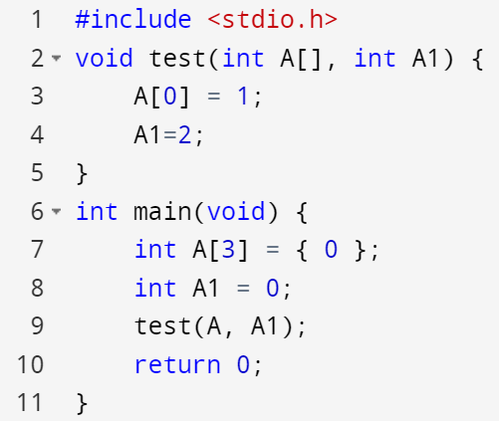
Pass-by-value vs. Pass-by-reference

Slide 23
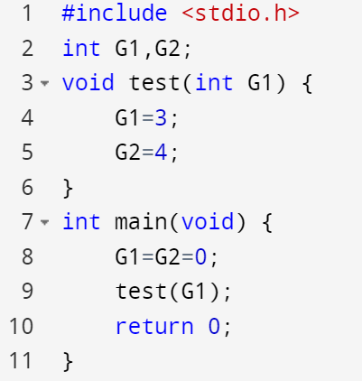
Global variable vs. Local variable

Slide 24
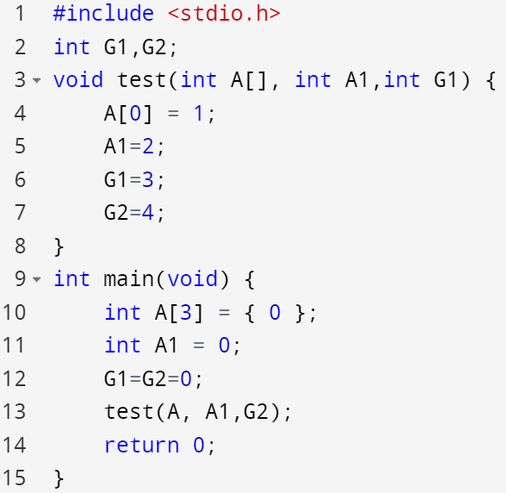
Notes:
#include <stdio.h>
int G1,G2;
void test(int A[], int A1,int G1) {
A[0] = 1;
A1=2;
G1=3;
G2=4;
}
int main(void) {
int A[3] = { 0 };
int A1 = 0;
G1=G2=0;
test(A, A1,G2);
printf("%d %d %d %d\n", A[0], A1,G1,G2);
return 0;
}

Slide 25
Pass-by-Value create a new variable copy the value cannot change the variable in main function Pass-by-Reference Array as parameter, function(int A[]) pass the address, same variable can change the array value in main function

